Slide 1
Advanced Operating Systems 20MCAT172 (Elective 1) Module V

Slide 2
Syllabus
Database Systems: Problem of Concurrency Control – Serializability – Basic Synchronization Primitives for Concurrency Control – Lock-Based Algorithms – Time-Stamped Based Algorithms – Optimistic Algorithms.
(Mukesh Singhal and Niranjan G. Shivaratri, “Advanced Concepts in Operating Systems – Distributed, Database, and Multiprocessor Operating Systems”, Tata McGraw-Hill, 2001.)
Notes:
A database is an organized collection of structured information, or data, typically stored electronically in a computer system. ... Together, the data and the DBMS, along with the applications that are associated with them, are referred to as a database system, often shortened to just database.
Some DBMS examples include MySQL, PostgreSQL, Microsoft Access, SQL Server, FileMaker, Oracle, RDBMS, dBASE, Clipper, and FoxPro.
There are various types of databases used for storing different varieties of data:
1) Centralized Database. ...
2) Distributed Database. ...
3) Relational Database. ...
4) NoSQL Database. ...
5) Cloud Database. ...
6) Object-oriented Databases. ...
7) Hierarchical Databases. ...
8) Network Databases.

Slide 3
Database Systems

Slide 4
Database Systems
• A database system consists of a set of shared data objects that can be accessed by users.
A data object can be a page, a file, a segment or a record.
For the purpose of concurrency control, we will view database as a collection of data objects (d1,d2,.....dm).
The state of a database is given by the values of its data objects.
In a database, certain semantic relationships, called consistency assertions or integrity constraints must hold among its data objects.
A database is said to be consistent if the values of its data objects satisfy all of its consistency assertions.
Notes:
Consistency (or Correctness) in database systems refers to the requirement that any given database transaction must change affected data only in allowed ways. An assertion is a consistency check that verifies that the contents of a page, structure, or other entity match what would otherwise be assumed.

Slide 5
Transactions
• A user interacts with a database by performing read and write actions on the data objects.
The actions of a user are normally group together (as a program) to form a single logical unit of interaction, termed a transaction.
A transaction consists of a sequence of read, compute and write statements that refer to the data objects of a database.
The following are the properties of a transaction:
A transaction preserves the consistency of a database.
A transaction terminates in finite time.

Slide 6
Transactions
A transaction that does not modify any data object but just read some of them is referred as a read-only transaction.
A transaction that modifies at least one date object is known as an update transaction or an update.
The term transaction is used in a general sense to stand for query or update.
For a transaction, the set of data objects that are read by it are referred to as it's Readset and the set of data objects that are written by it are referred to as its Writeset.
Readset of a transaction - RS(T)
Writeset of a transaction – WS(T)

Slide 7
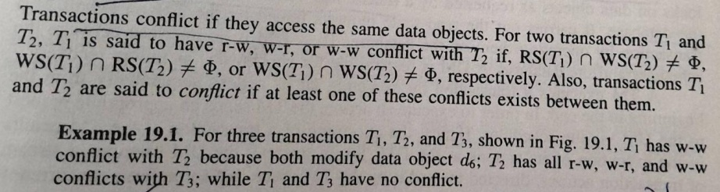
Transactions
Conflict in DBMS can be defined as two or more different transactions accessing the same variable and atleast one of them is a write operation.
There are three types of conflict in the database transaction.
Write-Read (WR) conflict
Read-Write (RW) conflict
Write-Write (WW) conflict

Slide 8
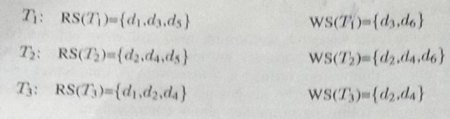
Transactions

Slide 9
Transaction Processing
A transaction is executing its action one by one from the beginning to the end.
A Read Action of a transaction is executed by reading the data object in the workspace of the transaction.
A Write Action of a transaction modifies a data object in the workspace and eventually writes it to the database.
Notes:
The workspace of a transaction is the area in the main memory that is allocated to it.

Slide 10
The Concurrency Control model of Database Systems
A database system consist of three software modules:
A transaction manager (TM)
A data Manager (DM)
A Scheduler
A TM supervises the execution of a transaction.
A TM interacts with the DM to carry out the execution of a transaction.
TM assign a timestamp to a transaction or issue requests to lock and unlock data objects on behalf of a user.
TM is an interface between users and the database system.

Slide 11
The Concurrency Control model of Database Systems
The scheduler is responsible for enforcing concurrency control.
It grants or releases locks on data objects as requested by a transaction.
The DM manages the database.
DM carries out the read-write requests issued by the TM.
DM is an interface between the scheduler and the database.
The DM is responsible for failure recovery.

Slide 12
The Concurrency Control model of Database Systems
A TM executes a transaction by executing all its actions sequentially from the beginning to the end.
In order to execute an action, the TM sends an appropriate request to the DM via the scheduler.
DM executes a stream of transaction actions.
To perform concurrency control, the scheduler modifies the stream of actions directed toward the DM.

Slide 13
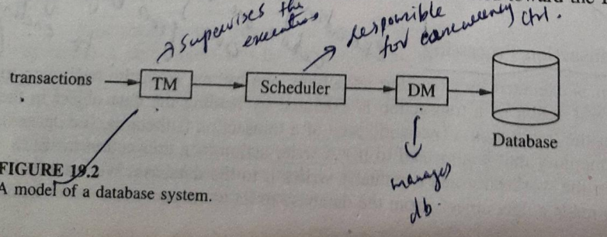
The Concurrency Control model of Database Systems

Slide 14
The Problem of Concurrency Control
In a database system, several transactions are under execution simultaneously.
Efficiency can be improved by executing transactions concurrently, ie, by executing read and write actions from several transactions in an interleaved manner.
Since concurrently running transactions may access the same data objects, the following situations may arise:
Inconsistent Retrieval
Inconsistent Update

Slide 15
The Problem of Concurrency Control
Inconsistent Retrieval
It occurs when a transaction reads some data objects of a database before another transaction has completed with its modification of those data objects.
Inconsistent Update
It occurs when many transactions read and write onto a common set of data objects of a database, leaving the database in an inconsistent state.
Notes:
Users interact with a database by running programs, called transactions, that issue reads and writes to the dbs.

Slide 16
Serializability
The transactions are set of instructions and these instructions perform operations on database.
When multiple transactions are running concurrently then there needs to be a sequence in which the operations are performed because at a time only one operation can be performed on the database.
This sequence of operations is known as Schedule.
When multiple transactions are running concurrently then there is a possibility that the database may be left in an inconsistent state.
Serializability is a concept that helps us to check which Schedules are serializable.
A serializable schedule is the one that always leaves the database in consistent state.
Execution of a transaction is modeled by a log and the correctness condition is stated in terms of logs.
Notes:
Serializability is the classical concurrency scheme. It ensures that a schedule for executing concurrent transactions is equivalent to one that executes the transactions serially in some order.

Slide 17
Serializability
LOGS
The serializability theory models executions of a concurrency control algorithm by a history variable called the log (also called schedule).
A log captures the chronological order in which read and write actions of transactions are executed under a concurrency control algorithm.
Let T= {T₀, T₁,.....T_{n}} be a transaction system. A log over T models an interleaved execution of T₀, T₁,.....T_{n} .

Slide 18
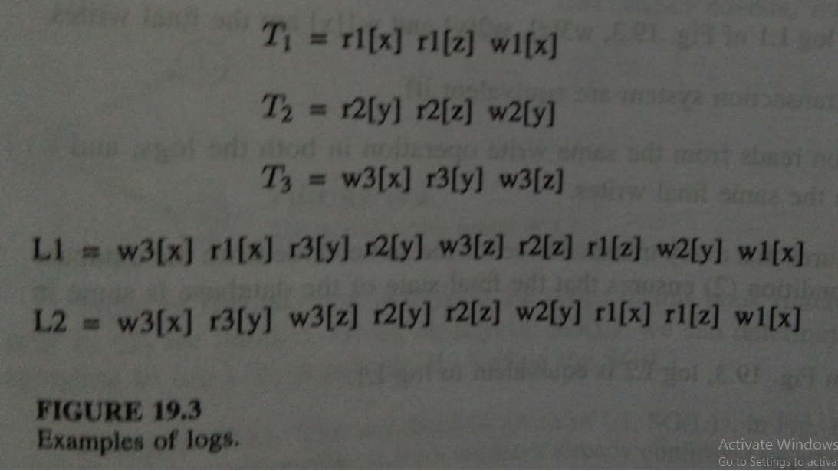
Serializability
LOGS

Slide 19
Serializability
Serial Logs
In a database system, if transactions are executed strictly serially, all the actions of each transaction must complete before any action of the next transaction can start, then the resulting log is termed a serial log.
A serial log represents an execution of transactions where actions from different transactions are not interleaved.
For eg. For a set of transactions T₁ , T₂ ,......, T_{n} , a serial log is of the form T_{i1} T_{i2} T_{in} ,where i1,i2,....,in is a subset of T1.
EXAMPLE : Log L2 of Fig. 19.3 (Actions from different transactions have not been interleaved)

Slide 20
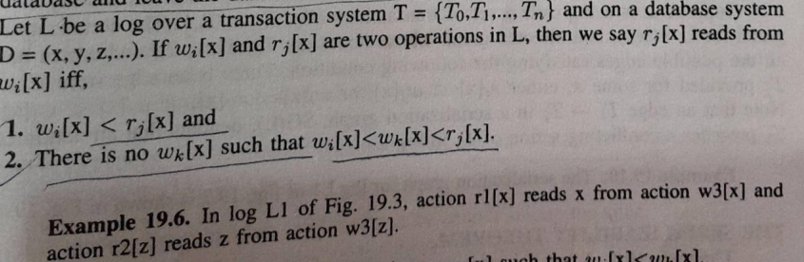
Serializability
Log Equivalence
Two logs are equivalent if all the transactions in both the logs see the same state of the database and leave the database in the same state after all the transactions are finished.

Slide 21
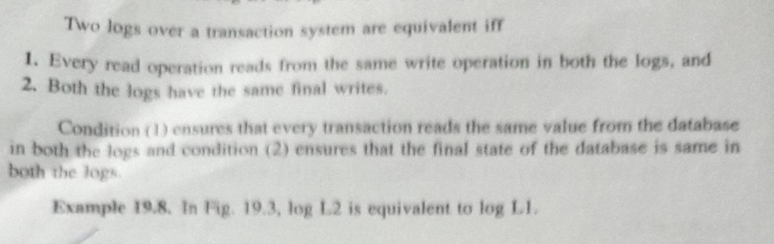
Serializability
Log Equivalence

Slide 22
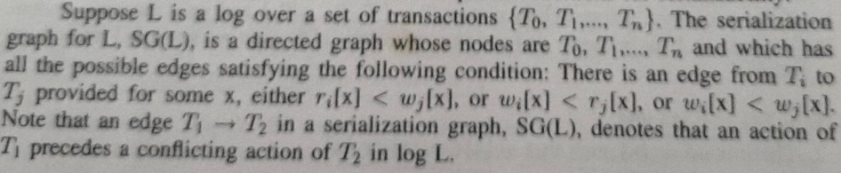
Serializability
The SerializabilityTheorem:
“ A log L is serializable iff SG(L) is acyclic. “
A serialization graph is constructed from a log.

Slide 23
Basic Synchronization Primitives for Concurrency Control

Slide 24
Basic Synchronization Primitives for Concurrency Control
Concurrency is the execution of the multiple instruction sequences at the same time.
It happens in the operating system when there are several process threads running in parallel.
The running process threads always communicate with each other through shared memory or message passing.
Concurrency results in sharing of resources result in problems like deadlocks and resources starvation.
It helps in techniques like coordinating execution of processes, memory allocation and execution scheduling for maximizing throughput.

Slide 25
Basic Synchronization Primitives for Concurrency Control
Principles of Concurrency :
Both interleaved and overlapped processes can be viewed as examples of concurrent processes, they both present the same problems.
The relative speed of execution cannot be predicted.
It depends on the following:
The activities of other processes
The way operating system handles interrupts
The scheduling policies of the operating system

Slide 26
Basic Synchronization Primitives for Concurrency Control
Problems in Concurrency :
Sharing global resources
Optimal allocation of resources
Locating programming errors
Locking the channel

Slide 27
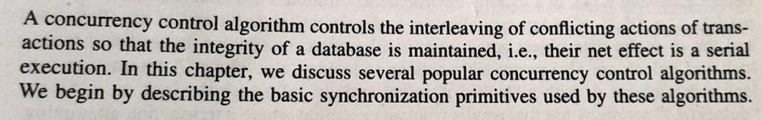
Concurrency Control Algorithms

Slide 28
Basic Synchronization Primitives
LOCKS
TIMESTAMPS

Slide 29
Basic Synchronization Primitives
LOCKS
Each data object has a lock associated with it.
A transaction can request, hold, or release the lock on a data object.
When a transaction holds a lock, the transaction is said to have locked the corresponding data object.
A transaction can lock a data object in two modes: Exclusive and Shared.
If a transaction has locked a data object in exclusive mode, no other transaction can concurrently lock it in any mode.
If a transaction has locked a data object in shared mode, other transactions can concurrently lock it but only in shared mode.
By locking data objects, a transaction ensures that the locked data objects are inaccessible to other transactions.

Slide 30
Basic Synchronization Primitives
TIMESTAMPS
A unique number that is assigned to a transaction or a data object.
Timestamps are commonly generated according to Lamport’s Scheme.
Timestamps have two properties:
Uniqueness
They are unique system wide.
Monotonicity
The value of timestamp increases with time.
Timestamps allow us to place a total ordering on the transactions of a distributed database system by simply ordering the transactions by their timestamps.

Slide 31
Lock-Based Algorithms

Slide 32
LOCK BASED ALGORITHMS
In lock based concurrency control algorithms, a transaction must lock a data object before accessing it.
In a locking environment, a transaction T is a sequence {a₁ (d₁), a₂ (d₂), ...., a_{n} (d_{n})} of n actions, where a_{i} is the operation performed in the ith action and the d_{i} is the data object acted upon in ith action.
Lock and Unlock are also permissible actions in locking algorithms.
A transaction can lock a data object d_{i} with a “lock(d_{i})” action and can unlock it by an “unlock(d_{i})” action.
A log that results from an execution where a transaction attempting to lock an already locked data object waits, is referred to as a legal log.

Slide 33
LOCK BASED ALGORITHMS
A transaction is well-formed if it
Locks a data object before accessing it.
Does not lock a data object more than once, and
Unlocks all the locked data objects before it completes.
To guarantee serializability, additional constraints needed, These constraints are expressed as locking algorithms.

Slide 34
LOCK BASED ALGORITHMS
STATIC LOCKING
In static locking, a transaction acquires locks on all the data objects it needs before executing any action on the data objects.
Static locking requires a transaction to pre-declare all the data objects it needs for execution.
A transaction unlocks all the locked data objects only after it has executed all of its actions.

Slide 35
LOCK BASED ALGORITHMS
STATIC LOCKING
Static Locking is conceptually very simple.
It seriously limits concurrency because any two transactions that have a conflict must execute serially.
Drawbacks
Limits the performance of database system.
It requires a priori knowledge of the data objects to be accessed by transactions. (Impractical in applications where the next data objects to be locked depends upon the value of another data object.)

Slide 36
LOCK BASED ALGORITHMS
Two-Phase Locking (2PL)
Dynamic Locking scheme in which a transaction requests a lock on a data object when it needs the data object.
Database consistency is not guaranteed if a transaction unlocks a locked data object immediately after it is done with it.
Two-Phase locking imposes a constraint on lock acquisition and the lock release actions of a transaction to guarantee consistency.

Slide 37
LOCK BASED ALGORITHMS
In two-phase locking, a transaction cannot request a lock on any data object after it has unlocked a data object.
Thus, a transaction must have acquired locks on all the needed data objects before unlocking a data object.
A two-phase locking has two phases:
A Growing Phase
Shrinking Phase

Slide 38
Two-Phase Locking (2PL)
A two-phase locking has two phases:
A Growing Phase
During which a transaction requests locks (Without releasing any lock)
Shrinking Phase
Which starts with the first unlock action, during which a transaction releases locks. (Without requesting any more locks)
The stage of a transaction when the transaction holds locks on all the needed data objects is referred to as its lock point.

Slide 39
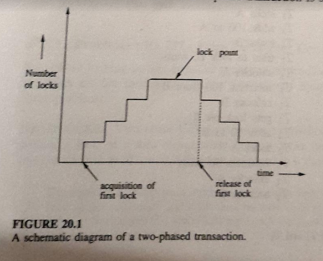
Two-Phase Locking (2PL)

Slide 40
Problems With 2PL
Two-Phase locking suffers from the problems of deadlock and cascaded aborts.
Two Phase locking is prone to deadlocks because a transaction can request a lock on a data object while holding locks on other data objects.
A set of transactions are deadlocked if they are involved in a circular wait.
When a transaction is rolled back, all the data objects modified by it are restored to their original states. In this case, all transactions that have read by them must also be restored and so on. This phenomenon is called the cascaded roll-back.
Two phase locking suffers from the problem of cascaded roll-back because a transaction may be rolled back after it has released the locks on some data objects and other transactions have read those modified data objects.
Notes:
Any dynamic locking policy will have these problems.

Slide 41
Timestamp-Based Locking
When a transaction is submitted, it is assigned a unique timestamp.
The timestamps of transaction specify a total order on the transactions and can be used to resolve conflicts between transactions.
When a transaction conflicts with another transaction, the concurrency control algorithm makes a decision based on the result of the comparison of their timestamp.

Slide 42
Timestamp-Based Locking
The use is to prevent deadlock.
Conflict Resolution: A conflicit is resolved by taking one of the following actions.
Wait-The requesting transaction is made to wait until the conflicting transaction either completes or aborts.
Restart-Either the requesting transaction or the transaction it conflicts with is aborted and started afresh.
Restarting is achieved by using one of the following primitives.
- Die- Requesting transaction aborts and starts afresh.
- Wound- The transaction in conflicit with the requesting transaction is tagged as wounded and a message “wounded” is sent to all sites that the wounded transaction has visited.
Wait-Die Algorithm
Wound-Wait Algorithm

Slide 43
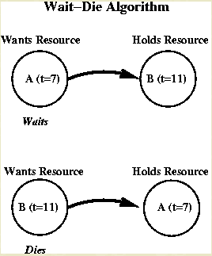
Timestamp-Based Locking
The Wait-Die algorithm:
Allow wait only if waiting process is older.
Since timestamps increase in any chain of waiting processes, cycles are impossible.

Slide 44
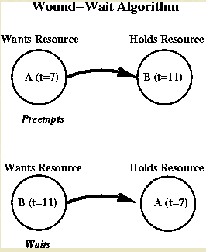
Timestamp-Based Locking
The Wound-Wait algorithm: Preemptive algorithm.
Allow wait only if waiting process is younger.
Here timestamps decrease in any chain of waiting process, so cycles are again impossible. It is wiser to give older processes priority.

Slide 45
Timestamp-Based Locking
Comparison Between The Algorithms
The Wound-Wait algorithm preempts the younger process. When the younger process re-requests resource, it has to wait for older process to finish. This is the better of the two algorithms.
Waiting Time:
In the WAIT-DIE algorithm, an older transaction is made to wait for younger ones.
In the WOUND-DIE algorithm, an older transaction never waits for younger ones and wound all the younger transactions.
Number of Restarts:
In the WAIT-DIE algorithm, the younger requester dies and is restarted.
In the WOUND-DIE algorithm, if the requester is younger, it waits rather than continuously dying and restarting.
Notes:
preemption is the act of temporarily interrupting an executing task, with the intention of resuming it at a later time. T

Slide 46
Non Two Phase Locking
When the data objects of a database system are hierarchically organized (hierarchical database systems), a non two phase locking protocol can ensure serializability and freedom from deadlocks.
In non-two-phase locking, a transaction can request a lock on a data object even after releasing locks on some data objects.
A data object cannot be locked more than once by the same transaction.
In order to access a data object, a transaction must first lock it.
If a transaction attempts to lock a data object that is already locked, the transaction is blocked.
When a transaction unlocks a data object, one of the transactions waiting for it gets a lock on it and resumes.

Slide 47
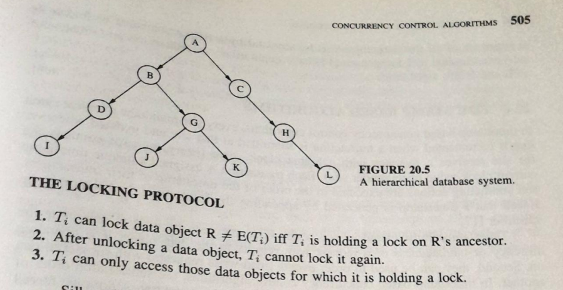
Non Two Phase Locking
When a transaction T_{i} starts, it selects a data object in the database tree for locking and can be subsequently lock the data objects only in the subtree with root node.

Slide 48
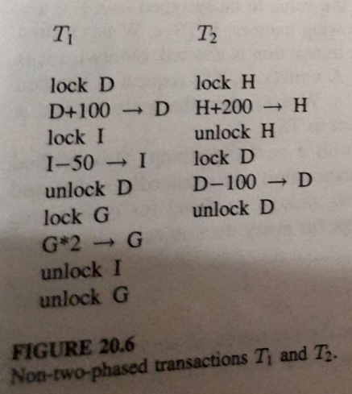
Non Two Phase Locking
.

Slide 49
Non Two Phase Locking
Advantages:
It is free from deadlocks.
A lock can be released when it is no longer needed.
The availability of data objects to other transaction is higher.

Slide 50
Time-Stamped Based Algorithms

Slide 51
Time-Stamped Based Algorithms
In timestamp based concurrency control algorithms, every site maintains a logical clock that is incremented when a transition is submitted at that site and updated whenever the site receives a message with a higher clock value.
Every message contains the current clock value of its sender site.
Each transaction is assigned a unique timestamp and conflicting actions are executed in the order of the timestamp of their transactions.
Timestamps can be used in two ways:
First, they can be used to determine the outdatedness of a request with respect to the data object it is operating on.
Second, they can be used to order events with respect to one another.
In timestamp based concurrency control algorithms, the serialization order of transactions is selected a priori (decided by their timestamp) and transactions are forced to follow this order.

Slide 52
Time-Stamped Based Algorithms
Timestamp based concurrency control algorithms are:
Basic Timestamp Ordering Algorithms
Thomas Write Rule (TWR)
Multiversion Timestamp Ordering Algorithm
Conservative Timestamp Ordering Algorithm

Slide 53
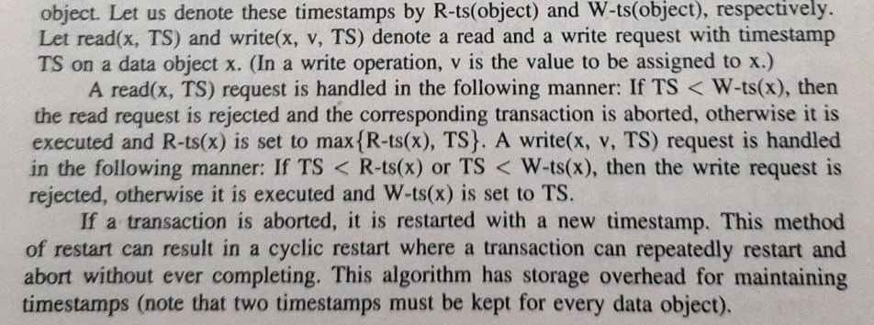
Basic Timestamp Ordering Algorithms (BTO )
The scheduler at each DM (Data Manager) keeps track of the largest timestamp of any read and write processed thus far for each data object.

Slide 54
Thomas Write Rule (TWR)
It states that, if a more recent transaction has already written the value of an object, then a less recent transaction does not need perform its own write since it will eventually be overwritten by the more recent one.
Is suitable only for the execution of write actions.
For a write( x, v, TS ), if TS < W-ts(x), then TWR says that instead of rejecting the write, simply ignore it.
This is sufficient to enforce synchronization among writes.
An additional mechanism is needed for synchronization between read and writes because TWR takes care of only write-write synchronization.
TWR is an improvement over BTO algorithm because it reduces the number of transaction aborts.
Notes:
the Thomas write rule is a rule in timestamp-based concurrency control. It can be summarized as ignore outdated writes.

Slide 55
Multiversion Timestamp Ordering Algorithm
A problem with 2PL is that it can lead to deadlocks.
Multiversion timestamp ordering scheme solves this problem by ordering transactions and aborting transactions that access data out of order.
It also increases the concurrency in the system by never making an operation block.
The basic idea in this scheme is to assign transactions timestamps when they are started, which are used to order these transactions.
If two transactions access data items in an order that is inconsistent with their time stamps, then one of them is aborted.

Slide 56
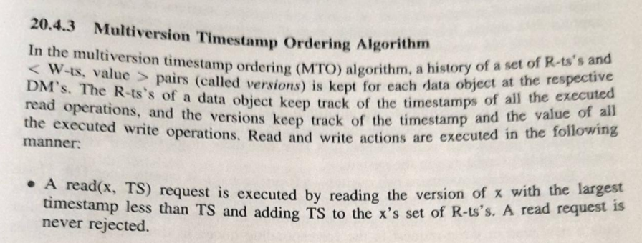
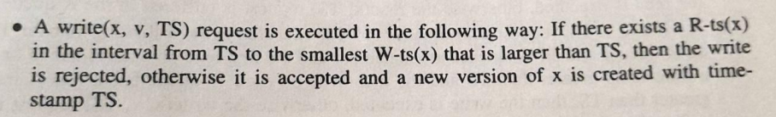
Multiversion Timestamp Ordering Algorithm

Slide 57
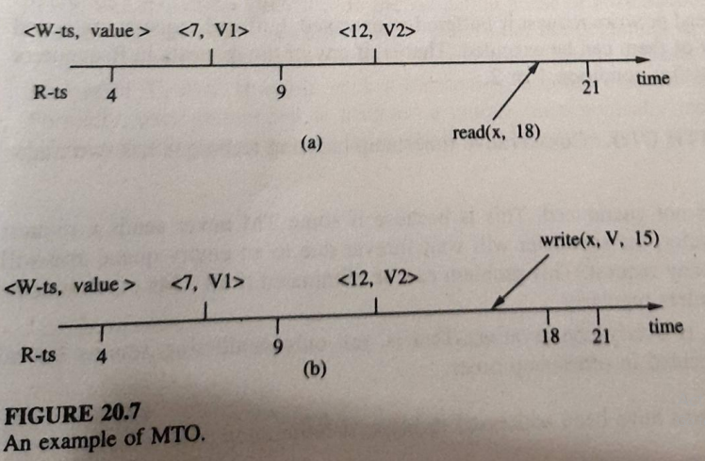
Multiversion Timestamp Ordering Algorithm

Slide 58
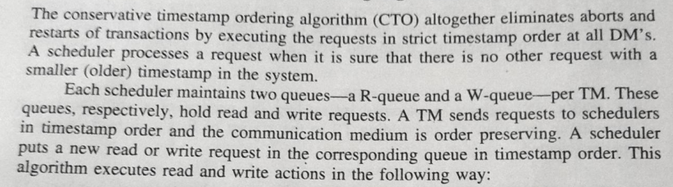
Conservative Timestamp Ordering Algorithm

Slide 59
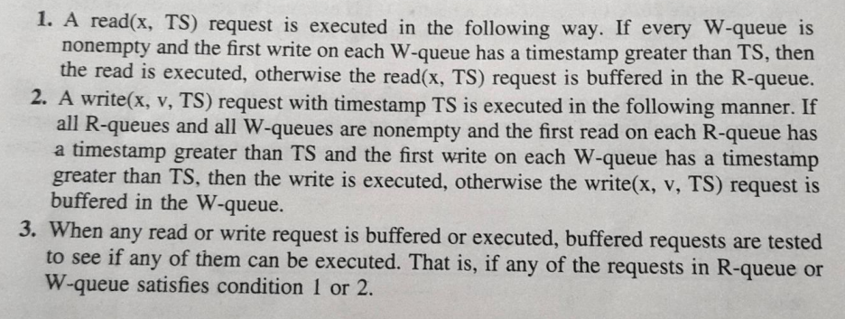
Conservative Timestamp Ordering Algorithm
.

Slide 60
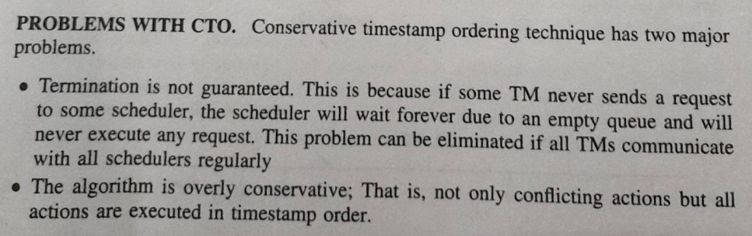
Conservative Timestamp Ordering Algorithm
.

Slide 61
Optimistic Algorithms

Slide 62
Optimistic Algorithms
Optimistic Concurrency Control Algorithms are based on the assumption that conflicts do not occur during execution time.
No synchonization is performed when a transaction is executed.
However, a check is performed at the end of the transaction to make sure that no conflicts have occured.
If there is a conflict, the transaction will be aborted.
Otherwise, the transaction is commited. Since conflicts do not occur very often, this algoritm is very efficient compared to other locking algorithms.
Notes:
Any dynamic locking policy will have these problems.

Slide 63
Optimistic Algorithms
Kung-Robinson Algorithm
Kung and Robinson were the first to propose an optimistic method for concurrency control.
The optimistic situation for this algorithm happens when
conflicts are unlikely to happen
the system consists mainly read-only transactions (such as a query dominant system)
Basic Idea: No synchonization check is performed during transaction processing time, however, a validation is performed to make sure there is no conflicts occurred. If a conflict is found, the tentative write is discarded and the transaction is restarted.
Notes:
Any dynamic locking policy will have these problems.

Slide 64
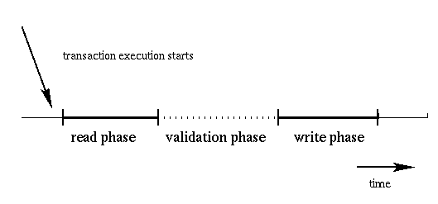
Optimistic Algorithms
The algorithm
Divide the execution of transaction into three phases:
Notes:
Any dynamic locking policy will have these problems.

Slide 65
Optimistic Algorithms
Read phase: data objects are read, the intended computation of the transaction is done, and writes are made on a temporary storage.
Validation phase: check to see if writes made by the transaction violate the consistency of the database. If the check finds out any conflicts, the data in the temporary storage will be discarded. Otherwise, the write phase will write the data into the database.
Write phase: If the validation phase passes ok, write will be performed to the database. If the validation phase fails to pass, all temporary written data will be aborted.
Notes:
Any dynamic locking policy will have these problems.

Slide 66
Thank You

